Slide 1
COMP814 Text Mining Introduction and Overview
Notes:
NLP v Text mining – same as programming v software development

Slide 2
Course Overview and Admin
Course Lecturer : Parma Nand
Room: WZ, level 11.
Phone: 921 999 ext 5679
Email: pnand@aut.ac.nz
Course Schedule
12 x 2 hour classes (room : WG707)
Lots of student directed research (more than 132 hours)
Assessment
Midway test 1 (40%) – Week 8 (lecture session) (the week back after mid-semester break)
Assignment 2 (60%) – will be given out in the week 9.
Pair based assignment.
Non assessed learning milestones
Quizz every week
Self assessment.
Answers available immediately after the attempt.
Lab every week.
Learning tool

Slide 3
Format of Lectures
Lecture followed by lab
Lectures will introduce new content demonstrated by python examples
Labs
Labs will reinforce the content using examples
Labs will need to be submitted before the beginning of the next session.
Labs will not contribute directly towards course marks but will be used in boarder line cases.
The submission will need to be a genuine (could be raw) attempt, rather than polished work as you would do for an assignment
Quizzes
Each (Except the test week) week will have a quiz you can do to assess your grasp of the content for that week.
You should finish the lab before attempting the quiz.
Should finish it before the next session.
Answers will be available after finishing the quiz.

Slide 4
Programming environment
We will use python as the language and Google Colab as the IDE
You can use Pycharm or another online environment, of your choice, such as Jupyter Notebook. Link given as part of the lab sheet.
You can install Jupyter separately, with python, or use the Anaconda package (contains python and commonly data science libraries) for your python install.
You can download the following if you intend to work in an offline environment.
Python environment (3.5 and above)
PyCharm as the IDE.
OR you can download PyCharm and python as a bundle.
Despite what you install you will need to download additional packages as and when needed depending on the task at hand.

Slide 5
Text Mining (TM) v Natural Language Processing (NLP)
Similar but not same
TM – applied
NLP – fundamentals
Software Engineering v Computer Science
Other AI disciplines
Data Mining
Machine Learning

Slide 6
Goals of the course
To appreciate the value of Text Mining.
To appreciate the multi-dimensional nature of processing knowledge represented as a natural language.
To build an understanding of the current state of play in the TM/NLP discipline.
To build and/or use TM tools.
At the end you would be able to progress research in a chosen area of NLP – either theoretical or implementation
Notes:
Text Comma separated files
Databases
Internet
Information overload
Free text
Humans use features
Machine learning needs features to work with
Too many features
Sense of a word eg. Bank,
Context
Syntax
Etc.

Slide 7
Why TM?
Needed to take advantage of the vast amount of information encoded in natural languages, online as well as offline.
Needed even to interface with vast amount of organized information in databases.
Needed to be able to communicate with machines using natural language (NLG).

Slide 8
Previous/Current State of NLP
NLP is “hard”
NLP is still a largely unsolved problem
NLP is largely multidisciplinary in nature
Is partly the reason for NLP being a “hard” problem to solve.
In spite of this, NLP has progressed immensely in the last few years
Since since it became generative
Why??
What are LLMs? Pros/cons?

Slide 9
Disciplines of NLP
Linguistics : How words, phrases, and sentences are formed.
- Psycholinguistics : How people understand and communicate using a human language.
Computational linguistics : Deals with models and computational aspects of NLP.
Artificial intelligence : issues related to knowledge representation and reasoning.
NL Engineering : implementation of large, realistic systems, like LLMs,such as ChatGpt and Bart
Text Mining : information extraction from text for a specific purpose (closely related to AI)

Slide 10
Applications of NLP
Text- based applications:
- finding documents on certain topics (document categorisation)
- information retrieval; search for keywords or concepts.
- (free) information extraction; relevant to a topic.
- text comprehension
- translation from a language to another
- summarization
- knowledge management
- Dialogue-based applications:
- human-machine communication
- question-answering
- tutoring systems
chatbots
- problem solving
- Speech – processing
Text to speech
Speech to text

Slide 11
An Example - Question Answering
Text :
First Union Corp is continuing to wrestle with severe problems. According to industry insiders at Pine Webber, their president, John R. Georgius, is planning to retire soon.
Question :
Who is the President of First Union Corp?

Slide 12
Basic levels of language processing
Morphological Knowledge - how words are constructed : e.g
friend, friendly, unfriendly, friendliness.
Syntactic Knowledge - how words can be put together to form
correct sentences, and the role each word play’s in the sentence. e.g
John ate the cake.
Semantic Knowledge - Words and sentence meaning. e.g
They saw a log.
They saw a log yesterday.
He saws a log.
Phonetic - how words are related to the sounds that realize them
Essential for speech processing.
He leads the team.
Lead is a heavy metal.

Slide 13
It gets even more complicated!
Pragmatic Knowledge - how sentences are used in different situations (contexts)
Mary grabbed her umbrella.
A) It is a cloudy day.
B) She was afraid of dogs.
Discourse Knowledge - how the meaning of words and sentences is effected by the previous sentences, e.g. pronoun resolution.
John gave his bike to Bill. He didn’t care much of it anyway.
John and Tom like apples and they eat them often.

Slide 14
Some more context examples – Ambiguities without context
John saw the boy in the park with a telescope
Fed raises interest rates half a percent in an effort to control inflation
Notes:
Who has the telescope? What is the most likely interpretation?
Second one – what is the meaning of “interest”?
interest – noun or modifier for rates?

Slide 15
Lexical Ambiguities
Rice flies like sand.
Flying planes is/are dangerous.
Notes:
Rice flies – flies is it a verb or a noun?
Flying – is it a verb or a modifier for planes.
Does are and is make the diff?

Slide 16
Semantic Ambiguities
Words with more than one meaning or sense
Also called polysemous words
John killed the wolf.
Bill killed the project.
Mary killed Jane.(in tennis or murdered her)

Slide 17
What is a discourse?
Sentences cannot be processed in isolation
a word, phrase, and utterance interpretation is shaped by the discourse or dialogue context
Connected via
Coreference
Ordering
Segmentation

Slide 18
Example by Charles Fillmore:
Please use the toilets, not the pool.
The pool for members only.
Notes:
An example of continuous semantic update.

Slide 19
Inference in Discourse Processing
There are several possible ways to interpret an utterance in context
We need to find the most likely interpretation
Discourse model provides a computational framework for this search

Slide 20
Some Models of Discourse Structure
Investigation of lexical connectivity patterns as the reflection of discourse structure
Specification of a small set of rhetorical relation among discourse segments
Adaption of the notion of grammar
Examination of intentions and relations among them as the foundation of discourse structure

Slide 21
Discourse Example - dialogue
1 A: I’m going camping next week. Do you have a two person tent I could borrow?
2 B: Sure. I have a two-person backpacking tent.
--------------------------------------------------------------------------------------------------------
3 A: The last trip I was on there was a huge storm.
4 A: It poured for two hours.
5 A: I had a tent, but I got soaked anyway.
6 B: What kind of tent was it?
7 A: A tube tent.
8 B: Tube tents don’t stand up well in a real storm.
9 A: True.
-------------------------------------------------------------------------------------------------------
10.B: Where are you going on this trip?
11.A: Up in the Minarets.
12.B: Do you need any other equipment?
13.A: No.
14.B: Okay. I’ll bring the tent tomorrow.

Slide 22
Cohesion
Assumption: Well-formed text exhibits strong lexical connectivity via use of:
Repetitions
Synonyms
Coreference

Slide 23
Discourse Example - dialogue
1 A: I’m going camping next week. Do you have a two person tent I could borrow?
2 B: Sure. I have a two-person backpacking tent.
--------------------------------------------------------------------------------------------------------
3 A: The last trip I was on there was a huge storm.
4 A: It poured for two hours.
5 A: I had a tent, but I got soaked anyway.
6 B: What kind of tent was it?
7 A: A tube tent.
8 B: Tube tents don’t stand up well in a real storm.
9 A: True.
-------------------------------------------------------------------------------------------------------
10.B: Where are you going on this trip?
11.A: Up in the Minarets.
12.B: Do you need any other equipment?
13.A: No.
14.B: Okay. I’ll bring the tent tomorrow.
Identify synonyms, repetitions and co-references
Notes:
Identify synonyms, repetitions and co-references

Slide 24
Rhetorical Structure Theory
Assumption: Clauses in well-formed text are related via predefined rhetorical relations
Evidence: a claim information intended to increase the readers’ belief in the claim

Slide 25
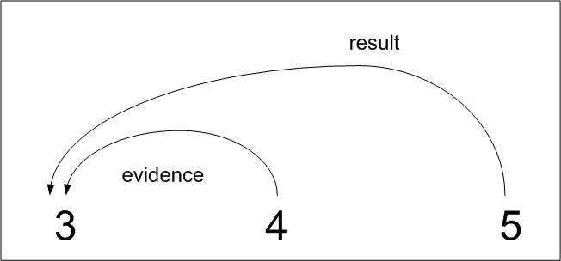
Rhetorical Structure Theory
3 The last trip I was on there was a huge storm.
4 It poured for two hours.
5 I had a tent, but I got soaked anyway.

Slide 26
Basic levels of language processing
All words in a sentence don’t have the same status
Need to identify basic components of sentences
Need to identify the (syntactic) structure of sentences
Can be ambiguous too!

Slide 27
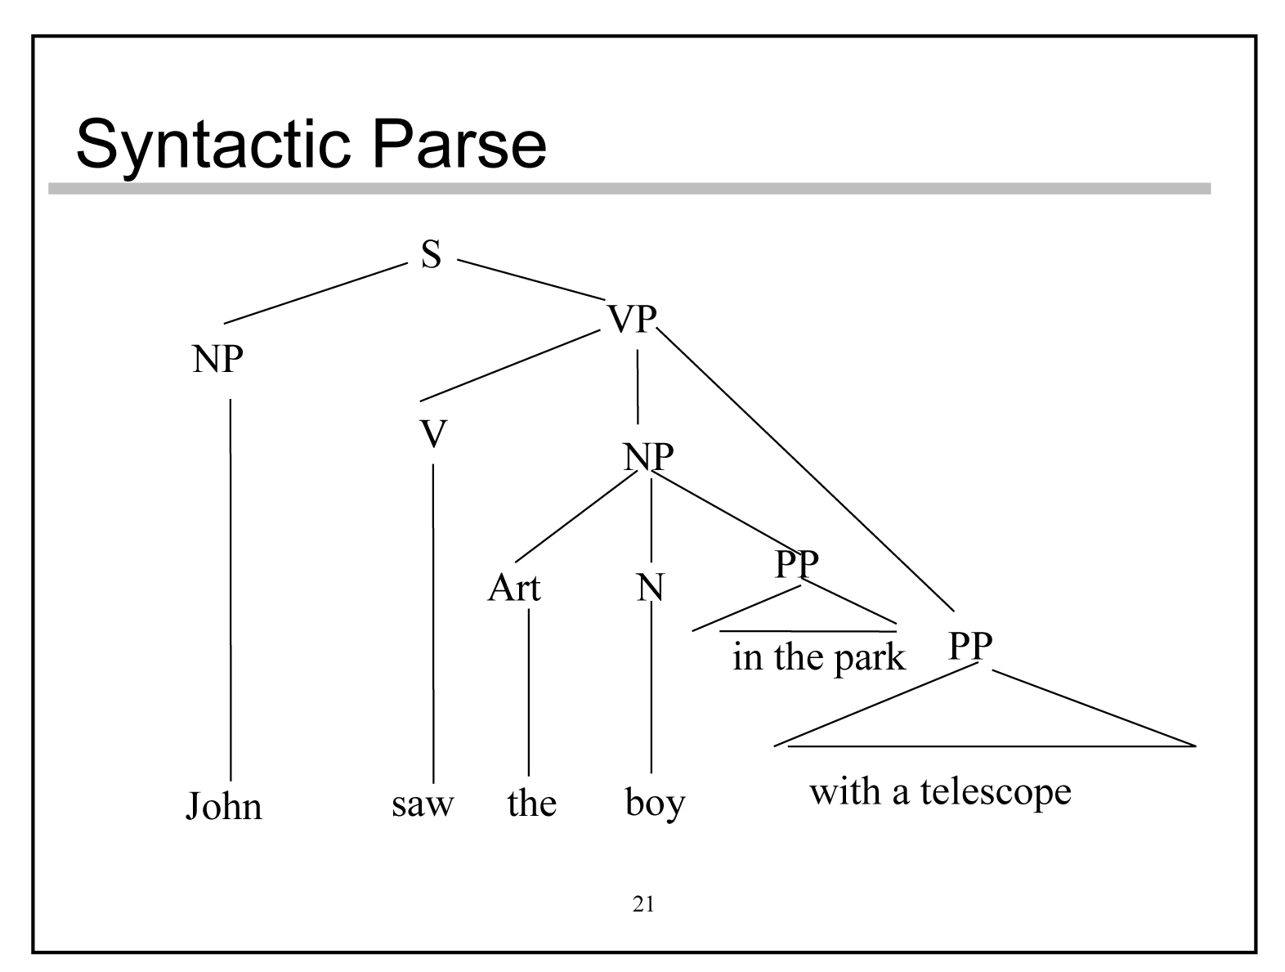
Syntactic structure of a sentence
John saw the boy in the park with a telescope

Slide 28
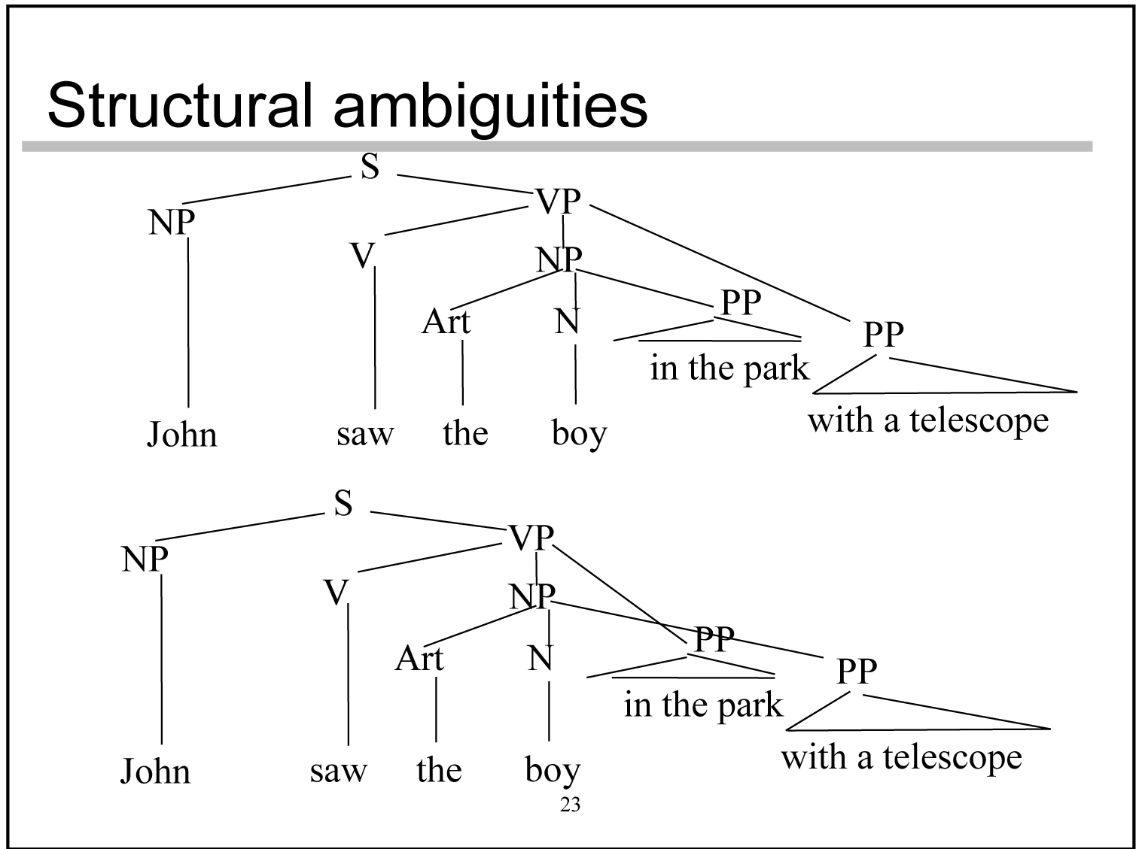
Two possible parses

Slide 29
State of the art in NLP Research
Association of Computational Linguistics ( ACL)
AAAI -every year /IJCAI -every second year
Natural Language Engineering (journal).
CICLing – Conference on intelligent Text Processing and Computational Linguistics
Information retrieval/ Extraction
MUC - Message Understanding Conf.
DUC – Document Understanding Conf.
SIGIR – Special Interest Group in IR

Slide 30
Resources
Machine Readable Dictionaries (MRD)
WordNet (www.cogsci.princeton.edu/~wn)
Large corpora:
Penn Treebank –
www.cis.upenn.edu/~treebank
All Treebank data is released through The Language Data Consortium (LDC)
RCV1
TRC2
Reuters21578
Ontonotes
Dbpedia
Freebase
WordNet

Slide 31
Penn Treebank Corpora
Corpus of 4.5 million words of American English
Part_of_Speech tagged
Syntactic Bracketing

Slide 32
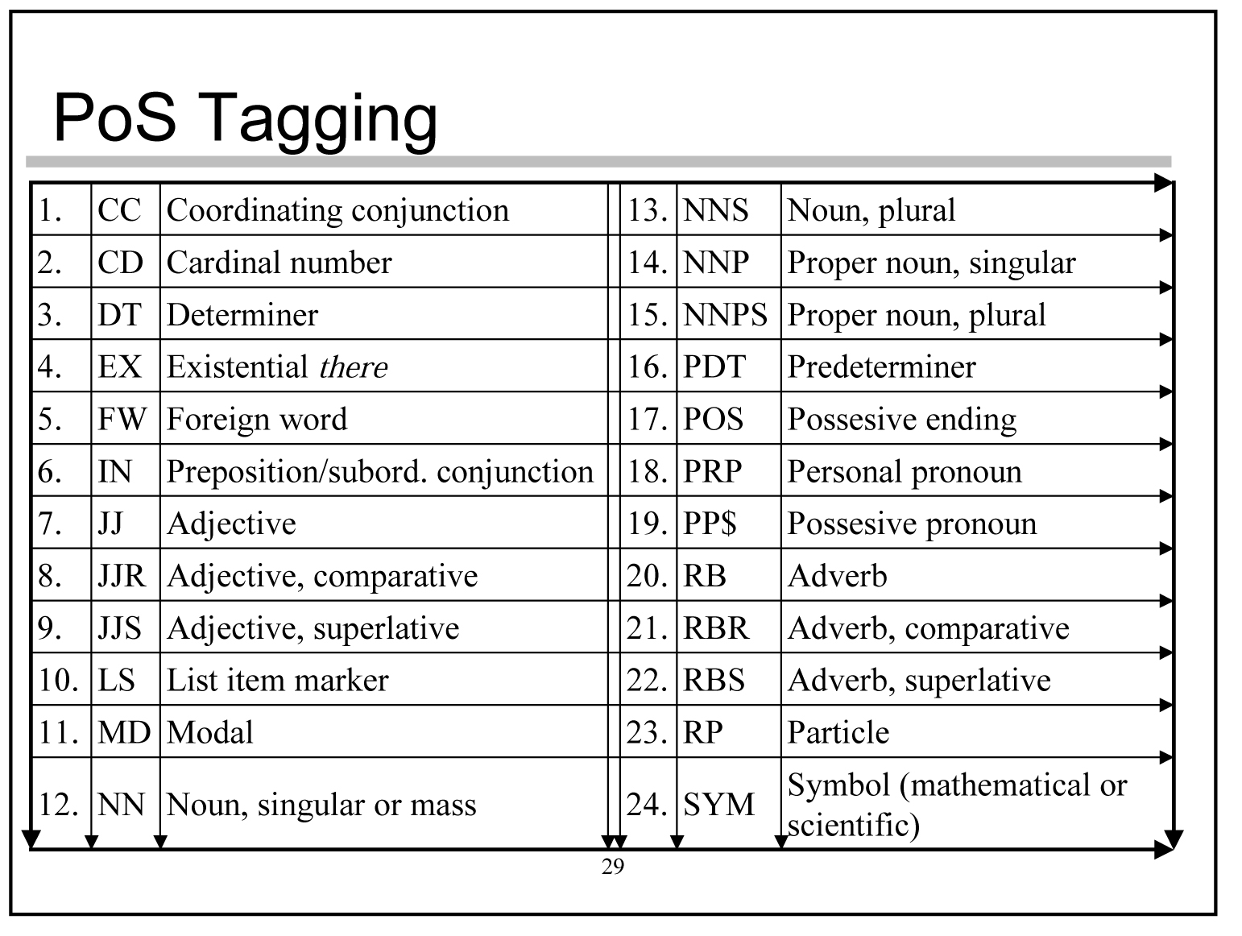
POS tags

Slide 33
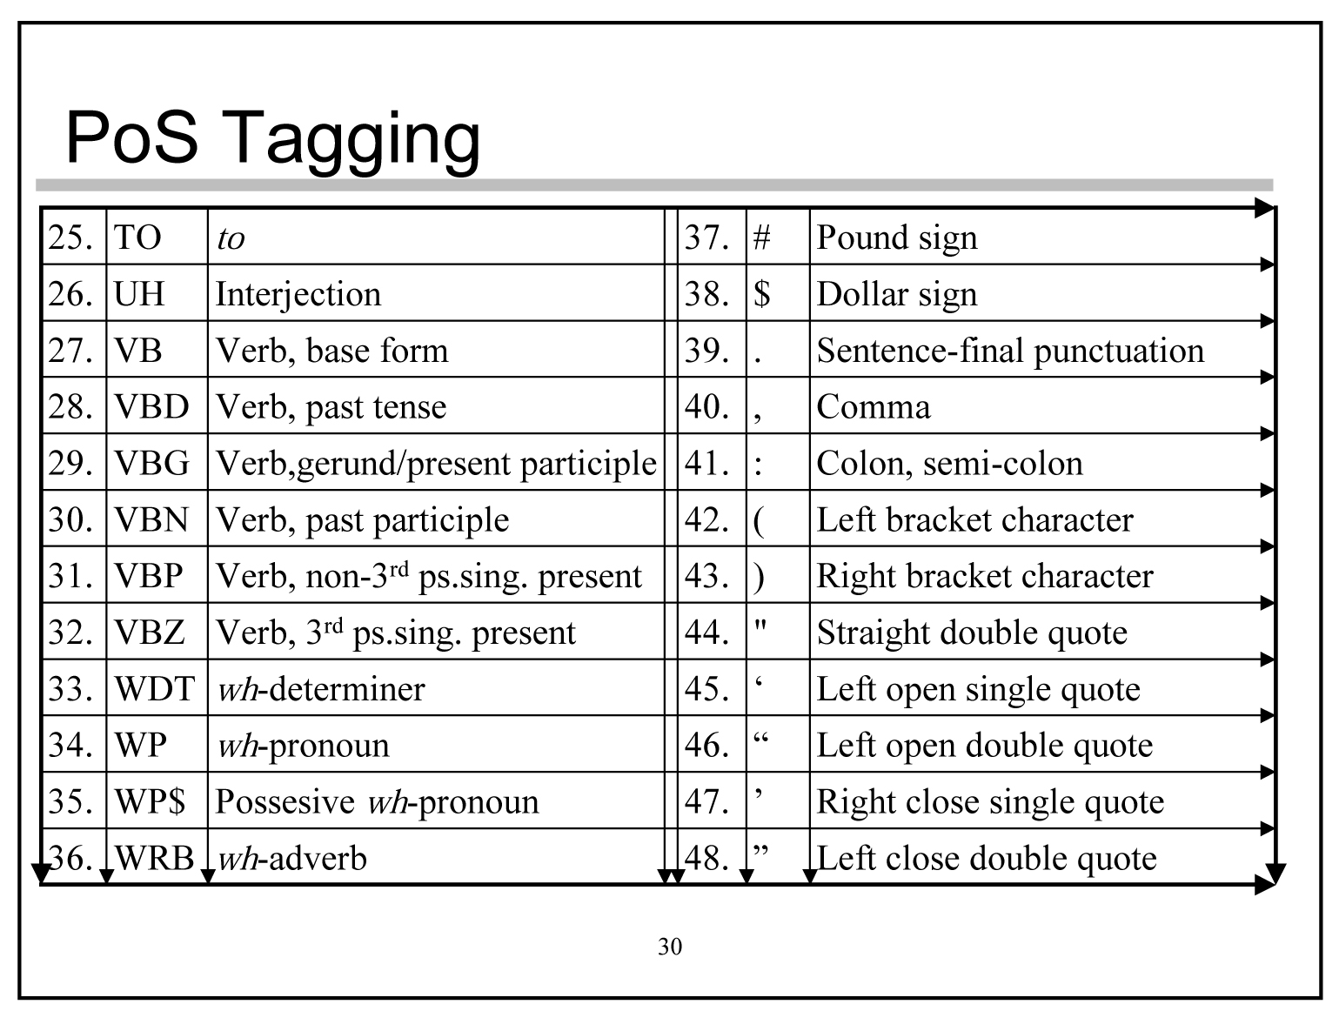
POS tags

Slide 34
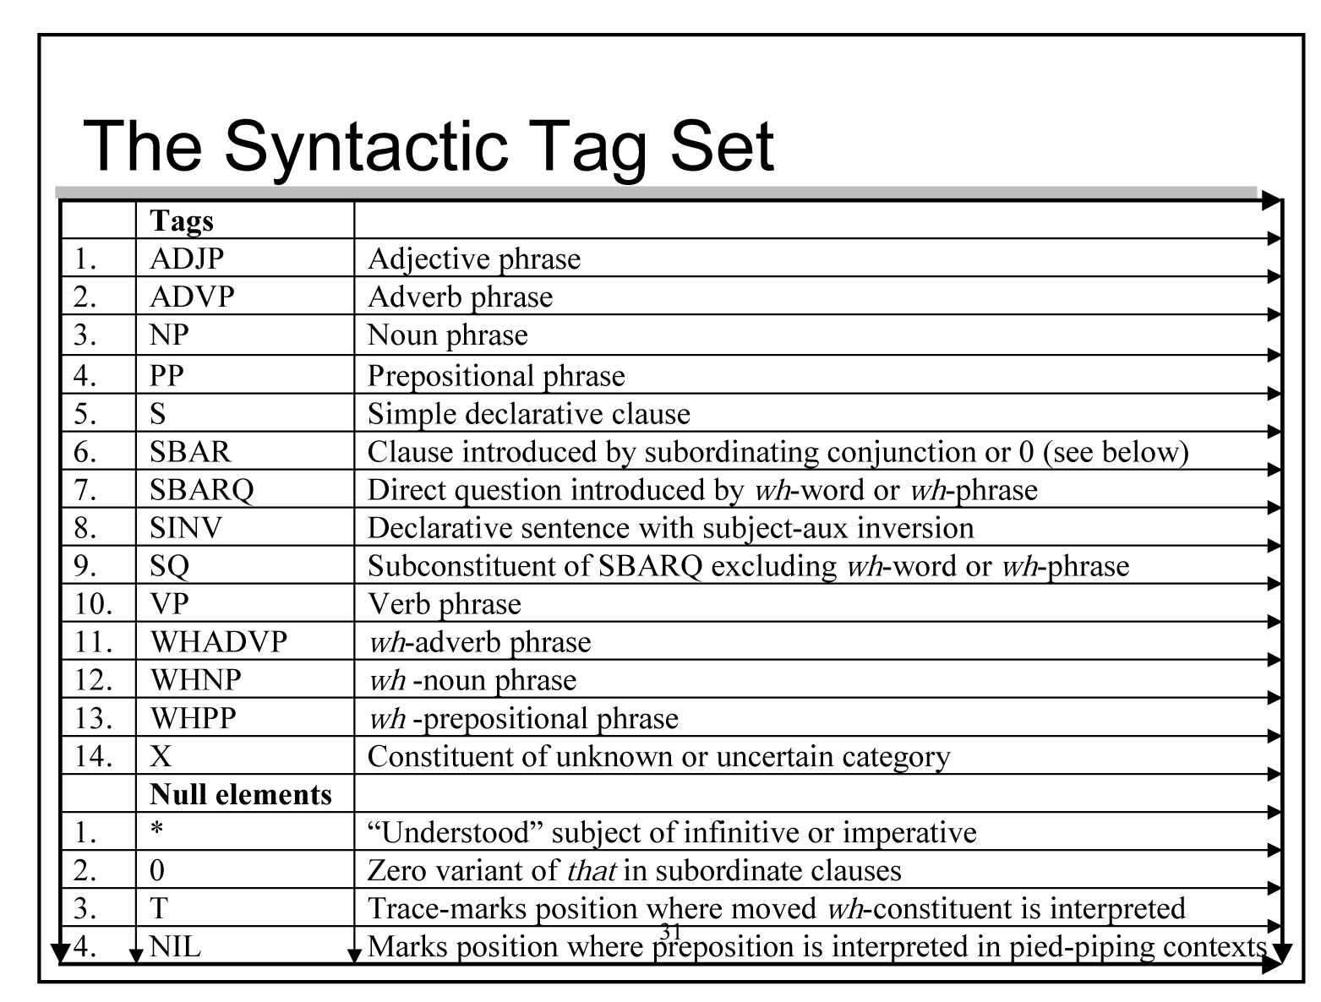
Syntactic tags

Slide 35
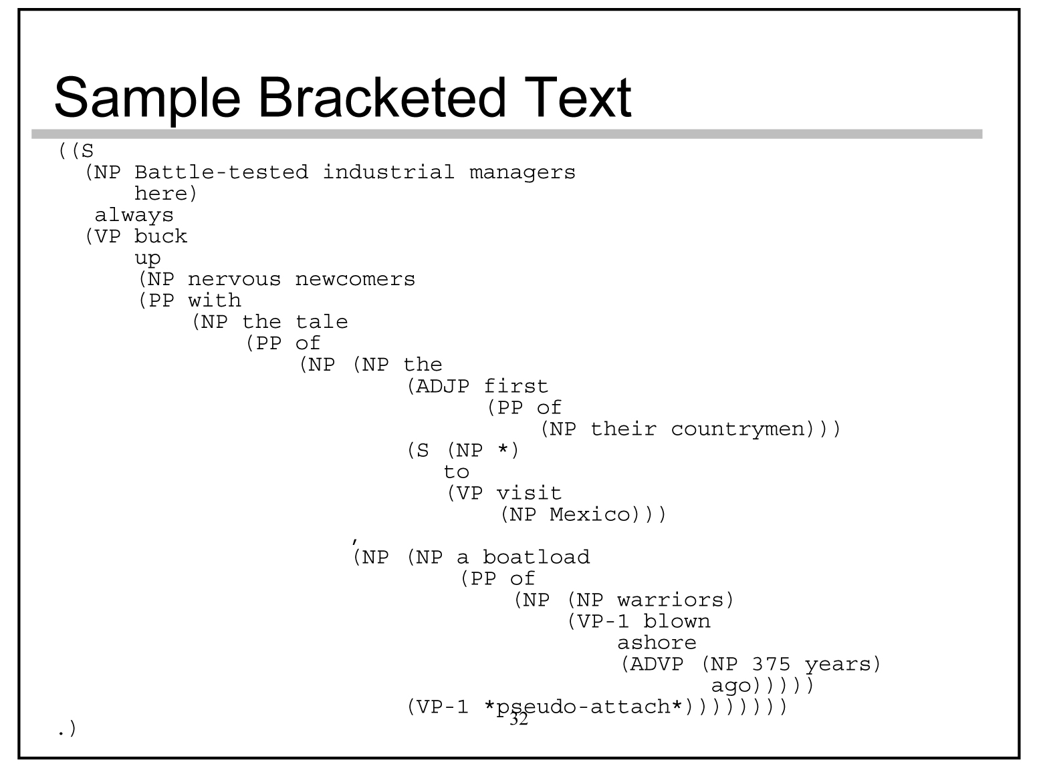
Sample bracketed text

